Slide 1

Agile Software Development
Module Number: 3
Agile Design Principles

Slide 2
Agile Software Development
        Syllabus
The Single-Responsibility Principle (SRP): Defining a Responsibility, Separating Coupled Responsibilities, Persistence,
The Open/Closed Principle (OCP), Description of OCP, The Shape Application.
The Liskov Substitution Principle (LSP): Violations of LSP, Factoring Instead of Deriving, Heuristics and Conventions,
The Dependency-Inversion Principle (DIP).

Slide 3
Agile Software Development
        AIM:
The aim of this module is to give the ideas to design the software through Agile

Slide 4
Agile Software Development
        Objectives:
The Objectives of this Module is to:
Understand the concepts of Agile Principles (SRP, OCP, LSP)
Demonstrate the ideas through Agile Design

Slide 5
Agile Software Development
        Outcomes:
At the end of this Module, Students will be able to:
Define Agile Design Principles
Describe about Agile Design Principles
Create agile based design

Slide 6
Agile Software Development
        Single Responsibility Principle (SRP)
SRP – Single Responsibility Principle
Described by De-Marco and Page Jones

Slide 7
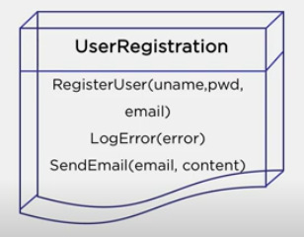
Agile Software Development
        Single Responsibility Principle (SRP)
Definition: A class should have only one reason to change.
Explanation:
Each Software Module should have one and only reason to change.

Slide 8
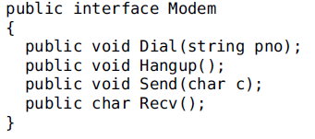
Agile Software Development
        Single Responsibility Principle (SRP)
User Registration Module:
The following class have to take care of,
1. Register User (Get user_name, pass_word, e_mail)
2. Log Error (Invalid user_name, pass_word, last successful login, log_in, log_out time)
3. Send Email (Forgot pass_word or reset_pass_word)

Slide 9
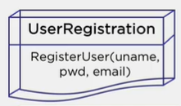
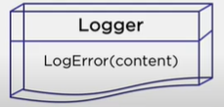
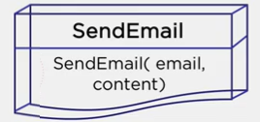
Agile Software Development
        Single Responsibility Principle (SRP)
Defining Responsibility

Slide 10
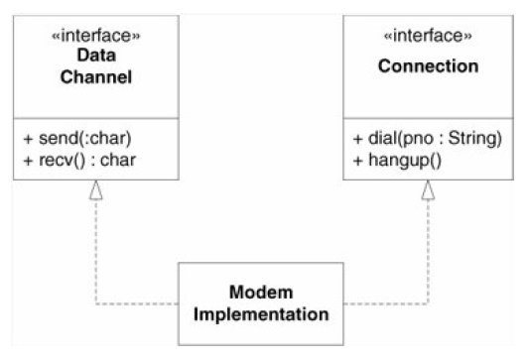
Agile Software Development
        Single Responsibility Principle (SRP)
Separating Coupled Responsibilities

Slide 11
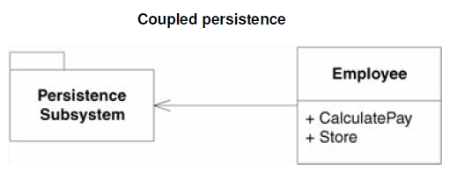
Agile Software Development
        Single Responsibility Principle (SRP)
Persistence
The Employee class contains business rules and persistence control.
These two responsibilities should almost never be mixed.

Slide 12
Agile Software Development
        Single Responsibility Principle (SRP)
Pros
Maintainability,
Testability
Flexibility, & Loosely Coupling
Cons
Simplest thing but difficult to maintain
Conjoining responsibilities usually easy but difficult to separate

Slide 13
The Open/Closed Principle

Slide 14

Agile Software Development
        The Open/Closed Principles (OCP)
Definition:
Software entities (classes, modules, functions, etc.) should be open for extension but closed for modification.
Description:
They are open for extension. This means that the behavior of the module can be extended.
They are closed for modification. Extending the behavior of a module does not result in changes to the source, or binary, code of the module.

Slide 15

Agile Software Development
        The Open/Closed Principles (OCP)
Abstraction:
An abstract class is a template definition of methods and variables of a class.
An abstract function is "just" a signature, without an implementation
Example:
Money withdrawal Constraints
1. 5 in Home ATMs
2. 3 in other ATMs
3. Minimum balance 1000/500
4. Unlimited PoS transactions

Slide 16
Agile Software Development
        The Open/Closed Principles (OCP)
abstract class Shape
{
abstract void draw();
}
class Rectangle extends Shape
{
void draw(){ System.out.println("drawing rectangle");}
}
class Circle extends Shape
{
void draw(){ System.out.println("drawing circle");}
}
class TestAbstraction{
public static void main(String args[])
{
Shape s=new Circle();
s.draw();
Shape s=new Rectangle();
s.draw();
}
}

Slide 17
Agile Software Development
        The Open/Closed Principles (OCP)
Pros
Flexibility
Reusability
Maintainability
Cons
Abstraction may not possible for all part of applications
Frequent changes may be required
Developer must be strong in OOP

Slide 18
The Liskov Substitution Principle

Slide 19
Agile Software Development
        The Liskov Substitution Principle (LSP)
Background
OCP → Achieved by Abstraction and Polymorphism
Inheritance proves the Base class usage in the Derived Class
But,
What are the design rules that govern this particular use of inheritance?
What are the characteristics of the best inheritance hierarchies?
What are the traps that will cause us to create hierarchies that do not conform to OCP?
Here it is,
LSP

Slide 20
Agile Software Development
        The Liskov Substitution Principle (LSP)
Definition:
Subtypes must be substitutable for their base types.
Explanation:
Barbara Liskov wrote this principle in 1988
“B” is subtype of “A”, then objects of “A” may be replaced with objects of “B”
Derived types must be completely substitutable for their base types
Simply, this is an extension of OCP

Slide 21
Agile Software Development
        Violations of LSP
public class Shape
{
private ShapeType type;
public Shape(ShapeType t){type = t;}
public static void DrawShape(Shape s)
{
if(s.type == ShapeType.square)
(s as Square).Draw();
else if(s.type == ShapeType.circle)
(s as Circle).Draw();
}
}
public class Circle : Shape
{
private Point center;
private double radius;
public Circle() : base(ShapeType.circle) {}
public void Draw() { }
}
public class Square : Shape
{
private Point topLeft;
private double side;
public Square() : base(ShapeType.square) {}
public void Draw() {}
}

Slide 22
Agile Software Development
        Factoring instead of Deriving
Factoring is a design tool that is best applied before there is much code written.
1. We can state that if a set of classes all support a common responsibility, they should inherit that responsibility from a common superclass.
Math Class (sqrt, pow, exp, ceil, floor)
2. If a common superclass does not already exist, create one, and move the common responsibilities to it.
Pi = 3.14
3. This new superclass will probably be an abstract class

Slide 23
Agile Software Development
        Heuristics and Conventions
There are some simple heuristics that can give you some clues about LSP violations.
public class Base
{
public void f() {/*some code*/}
}
public class Derived extends Base
{
public void f() {}
}

Slide 24
Agile Software Development
        The LSP Conclusion
The Open/Closed Principle is at the heart of many of the claims made for object-oriented design.
When this principle is in effect, applications are more maintainable, reusable.
The Liskov Substitution Principle is one of the prime enablers of OCP.
The substitutability of subtypes allows a module, expressed in terms of a base type, to be extensible without modification.
All this stuffs are possible by code (Example, Constant Variable)

Slide 25
The Dependency-Inversion Principle (DIP).

Slide 26

Agile Software Development
        The Dependency-Inversion Principle (DIP)
Rules:
High-level modules should not depend on low-level modules. Both should depend on abstractions.
Abstractions should not depend upon details. Details should depend upon abstractions.

Slide 27
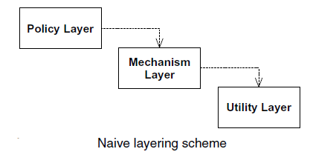
Agile Software Development
        The Dependency-Inversion Principle (DIP) Example with Layering
VC Office
Director Office
SE Dept. Office

Slide 28
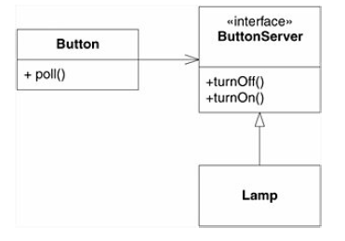
Agile Software Development
        The Dependency-Inversion Principle (DIP) Example with Lamp
Button
Server Interface
Lamp

Slide 29
Agile Software Development
        The Dependency-Inversion Principle (DIP) Pros and Cons
Pros:
  Object-oriented programming inverts that dependency structure
  So, policies depend on abstraction, and service interfaces are often owned by their clients.
  Inversion of dependencies is the hallmark of good object-oriented design.
Cons:
  Traditional procedural programming creates a dependency structure in which policy depends on details.
  Since the policies are then vulnerable to changes in the details

Slide 30
The Interface-Segregation Principle

Slide 31
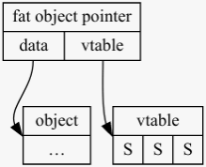
Agile Software Development
        The Interface Segregation Principle (ISP)
This principle deals with the disadvantages of “fat” interfaces.
Classes whose interfaces are not cohesive have “fat” interfaces.
The interfaces of the class can be broken up into groups of methods.
Each group serves a different set of clients.

Slide 32
Agile Software Development
        The Interface Segregation Principle (ISP) – Interface Pollution
Consider a security system in which Door objects can be locked and unlocked and know whether they are open or closed.
This Door is coded as an interface so that clients can use objects that conform to the Door interface without having to depend on particular implementations of Door.
public class Timer
{
public void Register(int timeout, TimerClient client)
{/*code*/}
}
public interface TimerClient
{
void TimeOut();
}
public interface Door
{
void Lock();
void Unlock();
bool IsDoorOpen();
}

Slide 33
Summary
Agile Software Development
        SOLID Principles - Summary

Slide 34
Self Assessment Questions & Assignment - 3

Slide 35
Agile Software Development
        Self Assessment Question
1. Solid principles was promoted by whom?
      Robert Hook
      Robert Rich
      Robert Martin
      Robert Dawn
      Answer: C. Robert Martin

Slide 36
Agile Software Development
        Self Assessment Question
2. Find the Odd one out.
      SRP
      OCP
      DIP
      OOP
      Answer: D. OOP

Slide 37
Agile Software Development
        Self Assessment Question
3. Subtypes must be substitutable is declared by,
      Liskov
      Robert
      John Mathews
      Joe Archer
      Answer: A. Liskov

Slide 38
Agile Software Development
        Self Assessment Question
4. Factoring instead of Deriving is defined in,
      SRP
      LSP
      OCP
      DIP
      Answer: B. LSP

Slide 39
Agile Software Development
        Self Assessment Question
5. “Simple Interfaces are best” quoted in,
      SRP
      LSP
      ISP
      DIP
      Answer: C. ISP

Slide 40
Assignment - 3

Slide 41
Consider your Assignment-1, if you allowed to use anyone of SOLID Principles to design, 1. which one will you use?
2. Make one simple design for a very small module?
You can use UML Diagrams/Code/ER Diagram or any mode to design.

Slide 42
Agile Software Development
        Document Link
Topic | URL | Notes
Times New Roman-14PT | https://www.scaledagileframework.com/refactoring/ | Times New Roman-14PT
Times New Roman-14PT | Times New Roman-14PT | Times New Roman-14PT
Times New Roman-14PT | Times New Roman-14PT | Times New Roman-14PT

Slide 43
Agile Software Development
        Video Link
Topic | URL | Notes
Times New Roman-14PT | Times New Roman-14PT | Times New Roman-14PT
Times New Roman-14PT | Times New Roman-14PT | Times New Roman-14PT
Times New Roman-14PT | Times New Roman-14PT | Times New Roman-14PT

Slide 44
Agile Software Development
        E- Book Link
Ebook name | Chapter | Page No. | Notes | URL
Times New Roman-14PT | Times New Roman-14PT | Times New Roman-14PT | Times New Roman-14PT | Times New Roman-14PT
Times New Roman-14PT | Times New Roman-14PT | Times New Roman-14PT | Times New Roman-14PT | Times New Roman-14PT

Slide 45
Thank you ALL!

